Slide 1
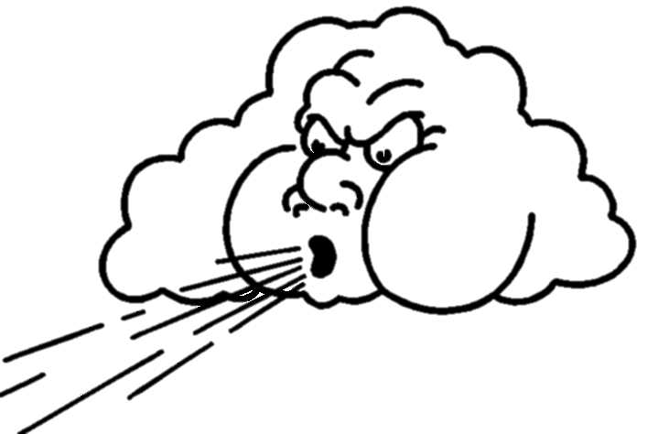
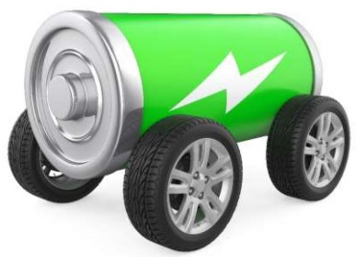
Aerodynamics

Slide 2
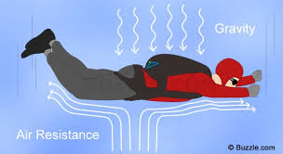
What is aerodynamics?
The study of the interaction between the air and solid bodies moving through it

Slide 3
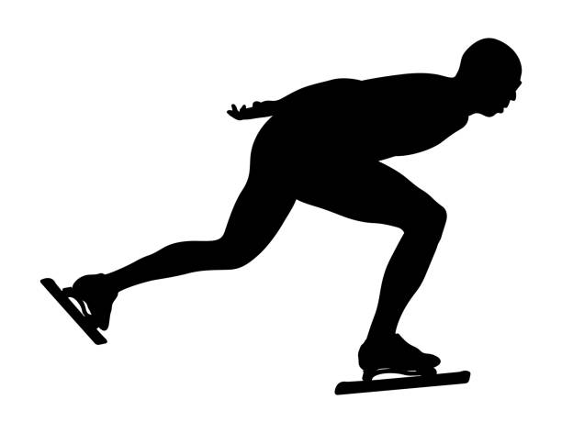
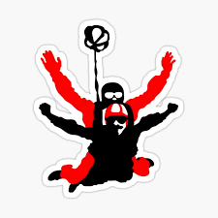
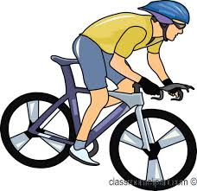
Aerodynamics and Sports

Slide 4
Aerodynamic Forces
Lift
Thrust
Drag
Weight

Slide 5
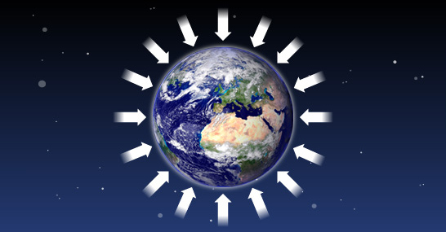
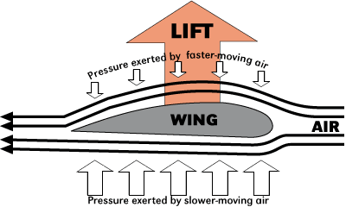
Weight
the force of gravity on an object. Everything on Earth has a weight.
Lift
the force on an object that causes it to become airborne. This is the opposite of weight.

Slide 6
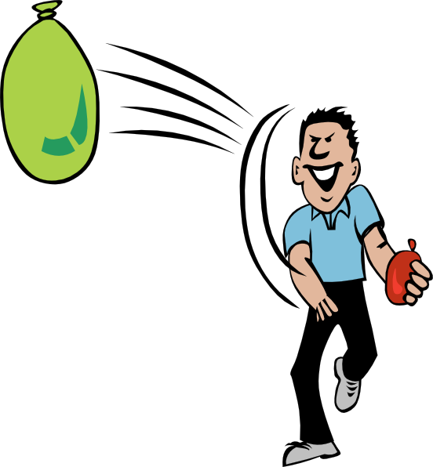
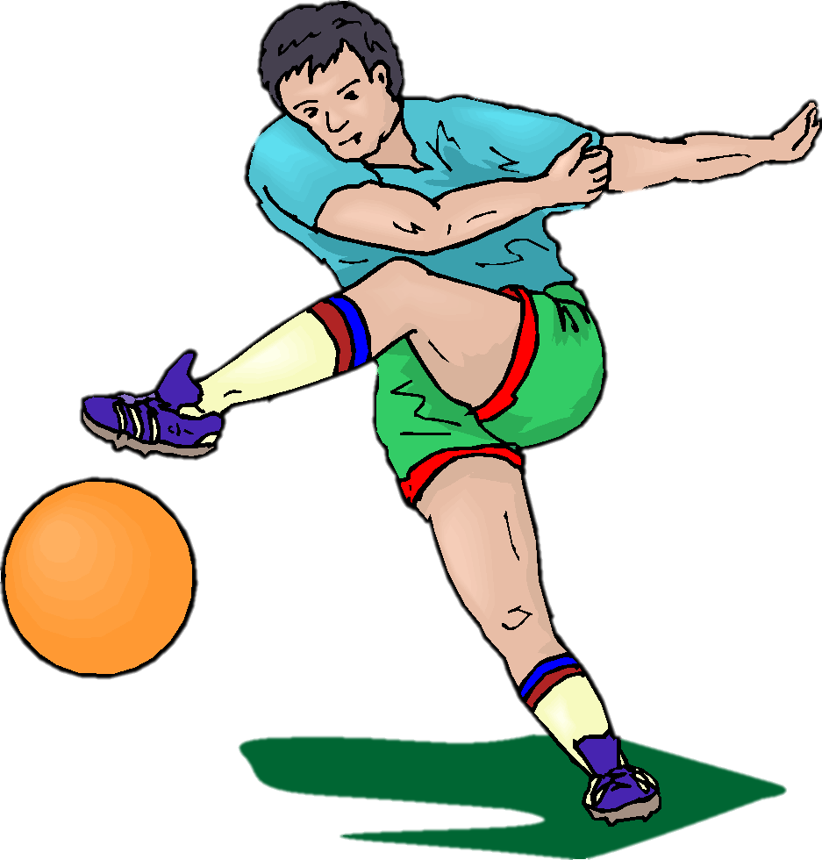
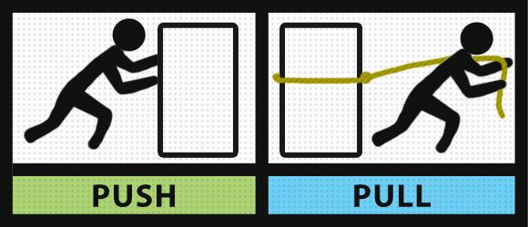
Thrust
The push or pull that moves something forward.

Slide 7
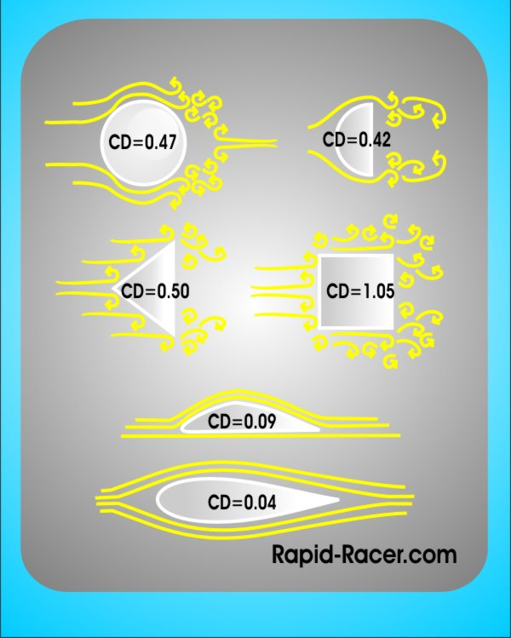
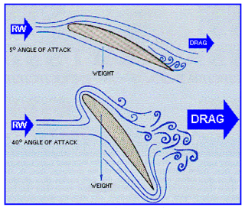
Drag
This is the force acting in the opposite direction to the object’s direction of movement.

Slide 8
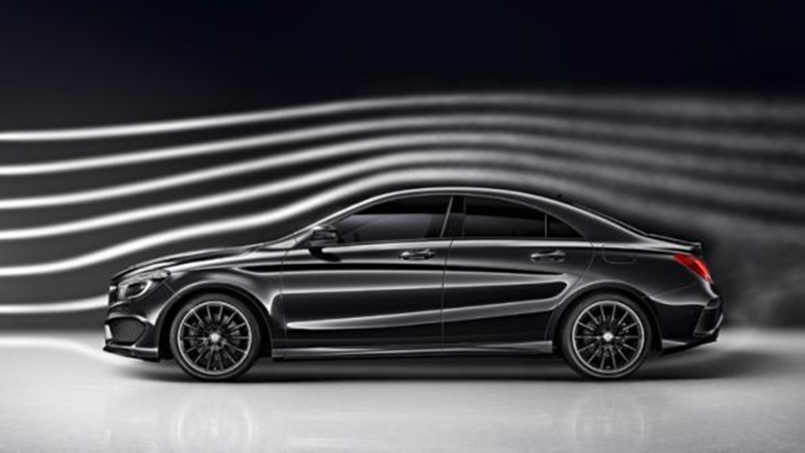
NASCAR Drag Video
https://www.scholastic.com/nascarspeed/index.html#

Slide 9
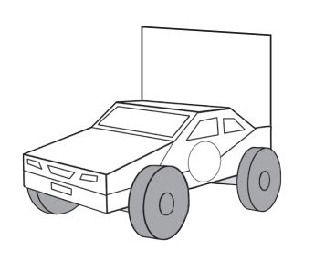
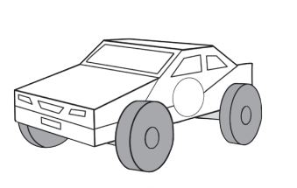
Testing Vehicle Aerodynamics
We will build test cars and see how aerodynamics affects their performance.

